Slide 1


Deep Architectures
18
PART IV · DEEP LEARNING AND MODERN AI
CHAPTER 18 · WEEK 11
Data Science — From Foundations to Intelligent Systems
LECTURER
Dr. Mustafa Hameed
THE ISLAMIA UNIVERSITY OF BAHAWALPUR
Bahawalpur, Pakistan
Department of Information Technology · BSIT · Fall 2026
Notes:
Chapter 18: Deep Architectures. Part 4 — Deep Learning and Modern AI. Week 11: Neural networks and architectures. Handout pages 115–121.

Slide 2

Where this chapter sits
THE COURSE
PART I
PART II
PART III
PART IV
PART V
PART VI
1
2
3
4
5
6
7
8
9
10
11
12
13
14
15
16
17
18
19
20
21
22
23
24
25
26
27
28
29
30
31
32
Deep Architectures
BUILDS ON
USED LATER IN
Ch 17 Neural Network Foundations
Ch 20 Text and Natural Language Processing
Ch 21 Generative AI and Large Language Models
Data Science · Chapter 18 · Deep Architectures
Handout p. 115 2
Notes:
Place the chapter. Before you start: Chapter 17 — neurons, layers, activations, backpropagation. Everything here is that machinery with the connections arranged differently.

Slide 3

What you will be able to do
LEARNING OUTCOMES
By the end of this chapter you will be able to:
1
Explain what convolution does and why it suits grid-structured data.
2
Describe how recurrent networks carry state across a sequence, and why LSTMs were needed.
3
State the core idea of attention and why it displaced recurrence.
4
Use an autoencoder for compression and anomaly detection.
5
Apply transfer learning and justify it on a small dataset.
Data Science · Chapter 18 · Deep Architectures
Handout p. 115 3
Notes:
Read these out: they are the chapter's contract with the room. Each click adds one.

Slide 4

Vocabulary for this chapter
KEY TERMS
convolution
kernel / filter
feature map
pooling
CNN
recurrent network
hidden state
LSTM
GRU
attention
self-attention
transformer
embedding
autoencoder
latent space
transfer learning
fine-tuning
Each term is defined where it first matters — not here.
Data Science · Chapter 18 · Deep Architectures
Handout p. 115 4
Notes:
Do not define these now; they arrive one at a time. This slide is for the students' notes. Terms: convolution; kernel / filter; feature map; pooling; CNN; recurrent network; hidden state; LSTM; GRU; attention; self-attention; transformer; embedding; autoencoder; latent space; transfer learning; fine-tuning.

Slide 5
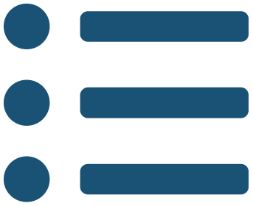
In this chapter
IN THIS CHAPTER
18.1
Architecture Is Inductive Bias
p. 115 ›
18.2
Convolutional Networks
p. 115 ›
18.3
Recurrent Networks
p. 116 ›
18.4
Attention and Transformers
p. 117 ›
18.5
Autoencoders
p. 118 ›
18.6
Transfer Learning
p. 118 ›
Data Science · Chapter 18 · Deep Architectures
Handout pp. 115–121 5
Notes:
The route through the chapter. Each row is a link: click it to jump to that section in the slide show.

Slide 6

The Idea Behind This Chapter
CONCEPT
A fully connected network treats every input the same way and must learn all structure from data. An architecture builds a structural assumption into the wiring: convolution assumes nearby pixels are related; recurrence assumes order matters; attention assumes any element may relate to any other. Choosing an architecture is choosing which assumption to give the model for free — which is why the right one needs far less data.
Data Science · Chapter 18 · Deep Architectures
§18.1 · Handout p. 115 6
Notes:
Read the box aloud, then ask for an example from the room before moving on.

Slide 7
Convolutional Networks
SECTION 2 OF 6
18.2
18.1 Architecture Is Inductive Bias
18.2 Convolutional Networks
18.3 Recurrent Networks
18.4 Attention and Transformers
18.5 Autoencoders
18.6 Transfer Learning
Data Science · Chapter 18
Handout §18.2 7
Notes:
Pause. Name the question this section answers.

Slide 8

Convolution
DEFINITION
Slide a small matrix of weights — a kernel or filter — across the input, computing a dot product at each position. The output is a feature map showing where in the input that pattern occurs. The same weights are reused at every position, which is called weight sharing.
Data Science · Chapter 18 · Deep Architectures
§18.2 · Handout p. 115 8
Notes:
Read the box aloud, then ask for an example from the room before moving on.

Slide 9
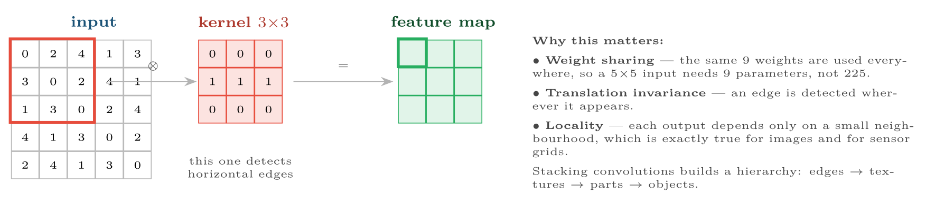
Convolutional Networks
FIGURE 18.1
Convolution. One small kernel slides over the whole input, so the network learns what to look for rather than where — a massive reduction in parameters compared with a fully connected layer.
Data Science · Chapter 18 · Deep Architectures
§18.2 · Handout p. 115 9
Notes:
Figure 18.1 (handout p. 116): Convolution. One small kernel slides over the whole input, so the network learns what to look for rather than where — a massive reduction in parameters compared with a fully connected layer.

Slide 10
Pooling
DEFINITION
Downsample a feature map by taking the maximum (or mean) over small windows. This shrinks the representation, reduces computation and grants a little tolerance to small shifts in position.
Data Science · Chapter 18 · Deep Architectures
§18.2 · Handout p. 115 10
Notes:
Read the box aloud, then ask for an example from the room before moving on.

Slide 11
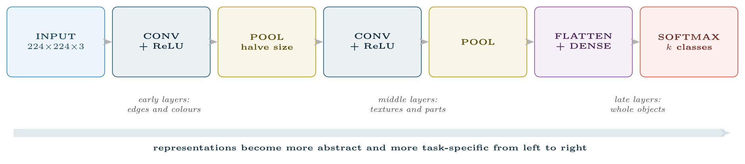
A typical CNN pipeline
FIGURE 18.2
The left-hand layers learn generic visual features that transfer to almost any image task — which is precisely what makes transfer learning work.
Data Science · Chapter 18 · Deep Architectures
§18.2 · Handout p. 115 11
Notes:
Figure 18.2 (handout p. 116): A typical CNN pipeline. The left-hand layers learn generic visual features that transfer to almost any image task — which is precisely what makes transfer learning work.

Slide 12
Recurrent Networks
SECTION 3 OF 6
18.3
18.1 Architecture Is Inductive Bias
18.2 Convolutional Networks
18.3 Recurrent Networks
18.4 Attention and Transformers
18.5 Autoencoders
18.6 Transfer Learning
Data Science · Chapter 18
Handout §18.3 12
Notes:
Pause. Name the question this section answers.

Slide 13
Recurrent Neural Network
DEFINITION
An RNN processes a sequence one element at a time, maintaining a hidden state h_{t} that summarises everything seen so far:
The same weights are applied at every timestep — weight sharing across time rather than across space.
Data Science · Chapter 18 · Deep Architectures
§18.3 · Handout p. 116 13
Notes:
Read the box aloud, then ask for an example from the room before moving on.

Slide 14

Why Plain RNNs Fail
WATCH OUT
Backpropagating through 100 timesteps multiplies 100 gradients together. If they are slightly below 1, the product vanishes and the network cannot learn long-range dependencies; slightly above 1 and it explodes. In practice a plain RNN forgets anything more than roughly ten steps back — which is useless for a sentence, a session or a day of telemetry.
Data Science · Chapter 18 · Deep Architectures
§18.3 · Handout p. 116 14
Notes:
Read the box aloud, then ask for an example from the room before moving on.

Slide 15
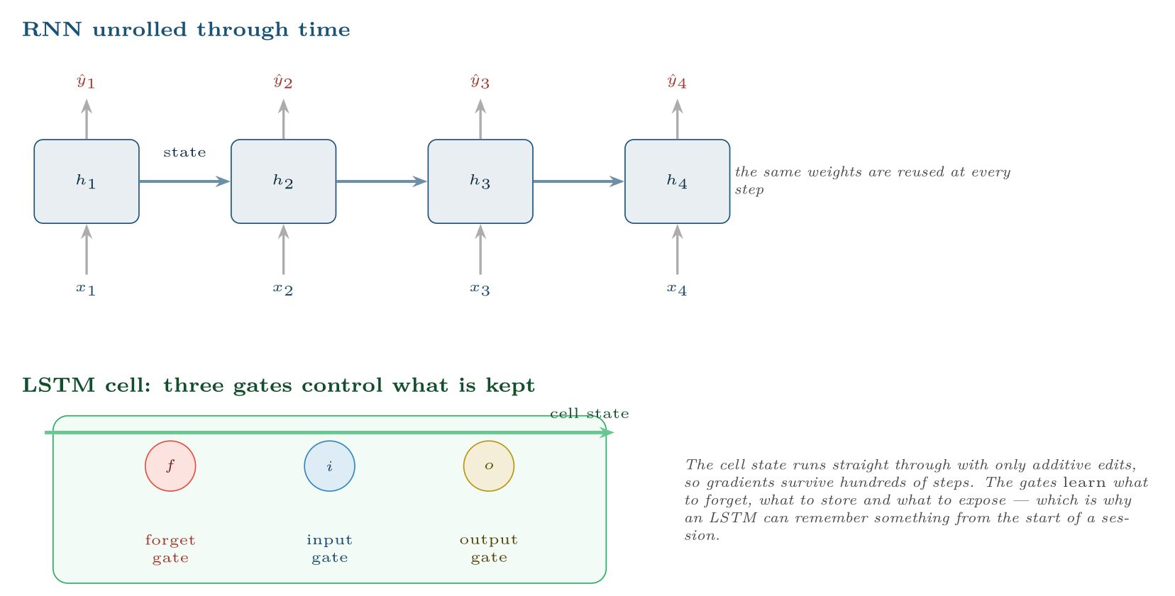
Recurrent Networks
FIGURE 18.3
Top: an RNN unrolled, carrying state forward. Bottom: an LSTM cell, whose gated cell state provides an uninterrupted path for gradients and solves the forgetting problem.
Data Science · Chapter 18 · Deep Architectures
§18.3 · Handout p. 116 15
Notes:
Figure 18.3 (handout p. 117): Top: an RNN unrolled, carrying state forward. Bottom: an LSTM cell, whose gated cell state provides an uninterrupted path for gradients and solves the forgetting problem.

Slide 16
Attention and Transformers
SECTION 4 OF 6
18.4
18.1 Architecture Is Inductive Bias
18.2 Convolutional Networks
18.3 Recurrent Networks
18.4 Attention and Transformers
18.5 Autoencoders
18.6 Transfer Learning
Data Science · Chapter 18
Handout §18.4 16
Notes:
Pause. Name the question this section answers.

Slide 17
Attention
DEFINITION
Instead of compressing a sequence into one hidden state, attention lets every position look directly at every other position and decide how much each one matters. Each output is a weighted average of all inputs, where the model learns the weights from the content.
Data Science · Chapter 18 · Deep Architectures
§18.4 · Handout p. 117 17
Notes:
Read the box aloud, then ask for an example from the room before moving on.

Slide 18
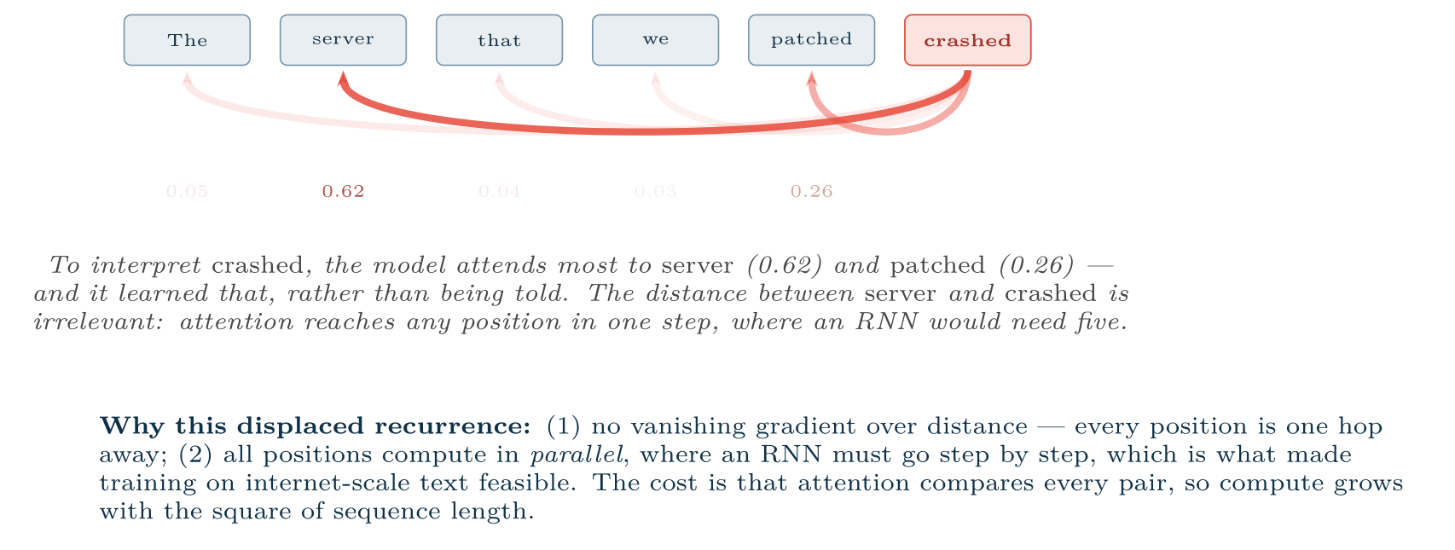
Self-attention
FIGURE 18.4
Each token’s representation is rebuilt as a weighted blend of all tokens, with the weights learned from content. This mechanism is the basis of every model in Chapters 20–22.
Data Science · Chapter 18 · Deep Architectures
§18.4 · Handout p. 117 18
Notes:
Figure 18.4 (handout p. 117): Self-attention. Each token’s representation is rebuilt as a weighted blend of all tokens, with the weights learned from content. This mechanism is the basis of every model in Chapters 20–22.

Slide 19
Transformer, in Three Sentences
CONCEPT
A transformer is a stack of blocks, each containing self-attention followed by a small feed-forward network, with residual connections and normalisation to keep training stable. Because the mechanism has no inherent notion of order, position information is added explicitly to each token’s embedding. Everything in Chapter 21 and Chapter 22 is built on this one design.
Data Science · Chapter 18 · Deep Architectures
§18.4 · Handout p. 117 19
Notes:
Read the box aloud, then ask for an example from the room before moving on.

Slide 20
Autoencoders
SECTION 5 OF 6
18.5
18.1 Architecture Is Inductive Bias
18.2 Convolutional Networks
18.3 Recurrent Networks
18.4 Attention and Transformers
18.5 Autoencoders
18.6 Transfer Learning
Data Science · Chapter 18
Handout §18.5 20
Notes:
Pause. Name the question this section answers.

Slide 21
Autoencoder
DEFINITION
A network trained to reproduce its own input through a narrow bottleneck. It must therefore learn a compressed latent representation that keeps only what matters. Trained only on normal data, it reconstructs normal inputs well and anomalous inputs badly — so reconstruction error becomes an anomaly score.
Data Science · Chapter 18 · Deep Architectures
§18.5 · Handout p. 118 21
Notes:
Read the box aloud, then ask for an example from the room before moving on.

Slide 22
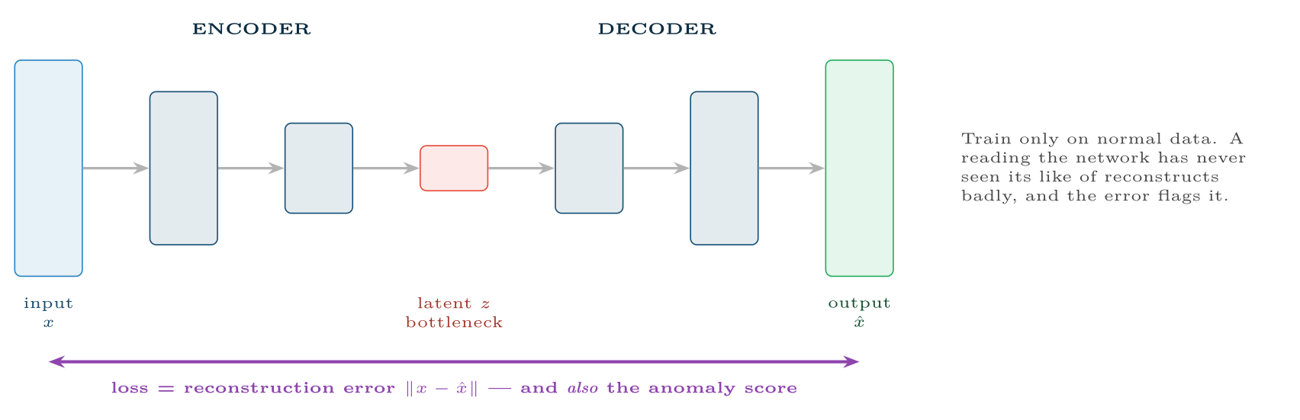
An autoencoder
FIGURE 18.5
The bottleneck forces a compressed representation; the reconstruction error that trains it also serves, at inference time, as an unsupervised anomaly score — which is why this architecture recurs in Chapters 25 and 26.
Data Science · Chapter 18 · Deep Architectures
§18.5 · Handout p. 118 22
Notes:
Figure 18.5 (handout p. 118): An autoencoder. The bottleneck forces a compressed representation; the reconstruction error that trains it also serves, at inference time, as an unsupervised anomaly score — which is why this architecture recurs in Chapters 25 and 26.

Slide 23
Transfer Learning
SECTION 6 OF 6
18.6
18.1 Architecture Is Inductive Bias
18.2 Convolutional Networks
18.3 Recurrent Networks
18.4 Attention and Transformers
18.5 Autoencoders
18.6 Transfer Learning
Data Science · Chapter 18
Handout §18.6 23
Notes:
Pause. Name the question this section answers.

Slide 24
Transfer Learning
DEFINITION
Take a model already trained on a large general dataset, keep its learned feature extractor, and re-train only the final layers on your small specific dataset. Because early layers learn generic structure (Figure 18.2), they transfer.
Data Science · Chapter 18 · Deep Architectures
§18.6 · Handout p. 118 24
Notes:
Read the box aloud, then ask for an example from the room before moving on.

Slide 25

Why Transfer Learning Changes What Is Possible
WORKED EXAMPLE
You must classify 800 photographs of industrial components as defective or sound.
From scratch: a usable CNN has millions of parameters. With 800 images it will memorise them within a few epochs. Realistic accuracy: poor, and unstable between runs.
With transfer learning: take a network pre-trained on ImageNet (1.2 million images, 1,000 categories). Freeze everything but the last block. Replace the 1,000-way output with a 2-way one. Now you are fitting a few thousand parameters, not a few million — and the frozen layers already detect edges, textures, corners and surface irregularities, which is most of what “defective” means visually.
Typical outcome: 800 images is comfortably enough, training takes minutes on a laptop rather than days on a GPU cluster, and the result is far more stable.
The general rule: unless you have hundreds of thousands of labelled examples, do not train a deep vision or language model from scratch. Fine-tune. This is the single most practical technique in this chapter.
Data Science · Chapter 18 · Deep Architectures
§18.6 · Handout p. 118 25
Notes:
Each click adds one step of the working. Ask for the next number before you reveal it.

Slide 26

Transfer Learning
AT A GLANCE
Architecture | Assumes | Input | Use for
Feed-forward (MLP) | Nothing about structure | Fixed-length vectors | Tabular data (but see Chapter 15)
CNN | Nearby values are related | Images, spectrograms, sensor grids | Vision, audio, some time series
RNN / LSTM / GRU | Order matters; recent past matters most | Sequences | Older sequence work; still fine for short series
Transformer | Any element may relate to any other | Sequences, text, images | Language, and increasingly everything else
Autoencoder | Normal data lies on a low-dimensional manifold | Anything | Compression, denoising, anomaly detection
Data Science · Chapter 18 · Deep Architectures
§18.6 · Handout p. 118 26
Notes:
Do not read the table row by row: pick the row the room is most likely to get wrong and ask why.

Slide 27





Four lenses: Choosing an Architecture
FOUR LENSES
LEARNING ANALYTICS
PROJECT MANAGEMENT
An LSTM or small transformer over the weekly clickstream sequence captures trajectory — “engaged then collapsed” versus “steadily low” — which aggregate features flatten away.
No deep architecture is appropriate at this data scale.
INTERNET OF THINGS
CYBERSECURITY
CNNs on spectrograms are the standard for vibration and acoustic monitoring: convert the waveform to a time–frequency image and the problem becomes a vision problem, with all of transfer learning available.
Autoencoders and sequence models over session logs detect behaviour that no signature covers.
Data Science · Chapter 18 · Deep Architectures
Handout p. 121 27
Notes:
The same method, four domains. Each of the next four slides opens one lens in full.

Slide 28

Learning Analytics: Choosing an Architecture
FOUR LENSES
LEARNING ANALYTICS
Project Management
An LSTM or small transformer over the weekly clickstream sequence captures trajectory — “engaged then collapsed” versus “steadily low” — which aggregate features flatten away. Worth the complexity only if you have several cohorts of history; with one cohort, the engineered trend features of Chapter 15 are both better and defensible.
Internet of Things
Cybersecurity
Data Science · Chapter 18 · Deep Architectures
Handout p. 121 28
Notes:
Learning Analytics. An LSTM or small transformer over the weekly clickstream sequence captures trajectory — “engaged then collapsed” versus “steadily low” — which aggregate features flatten away. Worth the complexity only if you have several cohorts of history; with one cohort, the engineered trend features of Chapter 15 are both better and defensible.

Slide 29

Project Management: Choosing an Architecture
FOUR LENSES
PROJECT MANAGEMENT
Learning Analytics
No deep architecture is appropriate at this data scale. The one legitimate use is a pre-trained language model applied to unstructured text — clustering requirement documents, or classifying retrospective notes by theme. That is transfer learning doing the work, not your 40 sprints.
Internet of Things
Cybersecurity
Data Science · Chapter 18 · Deep Architectures
Handout p. 121 29
Notes:
Project Management. No deep architecture is appropriate at this data scale. The one legitimate use is a pre-trained language model applied to unstructured text — clustering requirement documents, or classifying retrospective notes by theme. That is transfer learning doing the work, not your 40 sprints.

Slide 30

Internet of Things: Choosing an Architecture
FOUR LENSES
INTERNET OF THINGS
Learning Analytics
CNNs on spectrograms are the standard for vibration and acoustic monitoring: convert the waveform to a time–frequency image and the problem becomes a vision problem, with all of transfer learning available. Autoencoders handle the harder case where no failures have ever been recorded — train on normal operation and score reconstruction error. Both must then be shrunk to fit an edge device (Chapter 24).
Project Management
Cybersecurity
Data Science · Chapter 18 · Deep Architectures
Handout p. 121 30
Notes:
Internet of Things. CNNs on spectrograms are the standard for vibration and acoustic monitoring: convert the waveform to a time–frequency image and the problem becomes a vision problem, with all of transfer learning available. Autoencoders handle the harder case where no failures have ever been recorded — train on normal operation and score reconstruction error. Both must then be shrunk to fit an edge device (Chapter 24).

Slide 31

Cybersecurity: Choosing an Architecture
FOUR LENSES
CYBERSECURITY
Learning Analytics
Autoencoders and sequence models over session logs detect behaviour that no signature covers. CNNs applied to raw malware bytes treated as an image are a real and effective technique. But note the adversarial exposure: an attacker who can query your model can craft inputs that sit just inside the normal region, and deep models are more susceptible to this than simple ones — Chapter 26 covers the defences.
Project Management
Internet of Things
Data Science · Chapter 18 · Deep Architectures
Handout p. 121 31
Notes:
Cybersecurity. Autoencoders and sequence models over session logs detect behaviour that no signature covers. CNNs applied to raw malware bytes treated as an image are a real and effective technique. But note the adversarial exposure: an attacker who can query your model can craft inputs that sit just inside the normal region, and deep models are more susceptible to this than simple ones — Chapter 26 covers the defences.

Slide 32

Try it yourself: Transfer Learning and an Autoencoder
TRY IT YOURSELF
WHAT YOU WILL DO
1. Transfer learning: 800 images is enough
2. Autoencoder for unsupervised anomaly detection
THIS WEEK'S LAB
WHAT YOU WILL RUN
Week 11: Network from scratch; transfer learning
1 listing, 38 lines of Python
Data Science · Chapter 18 · Deep Architectures
§18.6 · Handout p. 118 32
Notes:
Say what the room will have at the end of the lab, then let them start. Circulate rather than lecture.

Slide 33
Transfer Learning and an Autoencoder
LAB · STEP 1 OF 3
Transfer learning: 800 images is enough
Python
1
2
3
4
5
6
7
8
9
10
11
12
13
14
15
16
# ---------- 1. Transfer learning: 800 images is enough ------------------
from tensorflow import keras
base = keras.applications.MobileNetV2(
input_shape=(224, 224, 3), include_top=False, weights="imagenet")
base.trainable = False # freeze the learned features
model = keras.Sequential([
base,
keras.layers.GlobalAveragePooling2D(),
keras.layers.Dropout(0.3),
keras.layers.Dense(1, activation="sigmoid"),
])
model.compile(optimizer=keras.optimizers.Adam(1e-3),
loss="binary_crossentropy", metrics=["AUC"])
# model.fit(train_ds, validation_data=val_ds, epochs=15)
Data Science · Chapter 18 · Deep Architectures
§18.6 · Handout p. 118 33
Notes:
Step 1: Transfer learning: 800 images is enough. Read the code aloud; ask what each line would print before running it.

Slide 34
Transfer Learning and an Autoencoder
LAB · STEP 2 OF 3
Transfer learning: 800 images is enough (continued)
Python
17
18
19
20
# Then unfreeze the top block and fine-tune at a LOW learning rate:
# base.trainable = True
# for layer in base.layers[:-20]: layer.trainable = False
# model.compile(optimizer=keras.optimizers.Adam(1e-5), ...) # 1e-5, not 1e-3
Data Science · Chapter 18 · Deep Architectures
§18.6 · Handout p. 118 34
Notes:
Step 2: Transfer learning: 800 images is enough (continued). Read the code aloud; ask what each line would print before running it.

Slide 35
Transfer Learning and an Autoencoder
LAB · STEP 3 OF 3
Autoencoder for unsupervised anomaly detection
Python
21
22
23
24
25
26
27
28
29
30
31
32
33
34
35
36
# ---------- 2. Autoencoder for unsupervised anomaly detection ----------
import numpy as np
n_feat = X_normal.shape[1]
ae = keras.Sequential([
keras.layers.Dense(32, activation="relu", input_shape=(n_feat,)),
keras.layers.Dense(8, activation="relu"), # bottleneck
keras.layers.Dense(32, activation="relu"),
keras.layers.Dense(n_feat), # reconstruct
])
ae.compile(optimizer="adam", loss="mse")
ae.fit(X_normal, X_normal, epochs=50, validation_split=0.1, verbose=0)
# ^^^^^^^^^ input and target are the same, and only NORMAL data is used
err = np.mean((X_all - ae.predict(X_all, verbose=0))**2, axis=1)
threshold = np.percentile(err[is_normal], 99) # set on normal data only
print("flagged:", (err > threshold).sum())
Data Science · Chapter 18 · Deep Architectures
§18.6 · Handout p. 118 35
Notes:
Step 3: Autoencoder for unsupervised anomaly detection. Read the code aloud; ask what each line would print before running it.

Slide 36

A 3×3 convolution kernel is applied to a 32×32 image. How many weights does the kernel have, and how many would a fully connected layer producing the same number of outputs need (roughly)?
CHECKPOINT 1 OF 3
Discuss with the person next to you, then advance.
Data Science · Chapter 18 · Deep Architectures
Handout p. 121 · answers in Appendix D 36
Notes:
Ask the room. Do not advance until someone commits to an answer.

Slide 37

A 3×3 convolution kernel is applied to a 32×32 image. How many weights does the kernel have, and how many would a fully connected layer producing the same number of outputs need (roughly)?
CHECKPOINT 1 OF 3 · ANSWER
The kernel has 3×3 = 9 weights (plus one bias). A fully connected layer mapping 32×32 = 1024 inputs to a similar number of outputs would need on the order of a million weights. This is the parameter saving that makes CNNs trainable.
Data Science · Chapter 18 · Deep Architectures
Handout p. 121 · answers in Appendix D 37
Notes:
Answer (Appendix D): The kernel has 3×3 = 9 weights (plus one bias). A fully connected layer mapping 32×32 = 1024 inputs to a similar number of outputs would need on the order of a million weights. This is the parameter saving that makes CNNs trainable.

Slide 38
Why can attention relate the first and hundredth word of a sentence more easily than an LSTM can?
CHECKPOINT 2 OF 3
Discuss with the person next to you, then advance.
Data Science · Chapter 18 · Deep Architectures
Handout p. 121 · answers in Appendix D 38
Notes:
Ask the room. Do not advance until someone commits to an answer.

Slide 39
Why can attention relate the first and hundredth word of a sentence more easily than an LSTM can?
CHECKPOINT 2 OF 3 · ANSWER
Attention connects any two positions in a single step, so the gradient path between them has length 1. An LSTM must propagate information through 99 intermediate steps, and the gradient degrades along the way.
Data Science · Chapter 18 · Deep Architectures
Handout p. 121 · answers in Appendix D 39
Notes:
Answer (Appendix D): Attention connects any two positions in a single step, so the gradient path between them has length 1. An LSTM must propagate information through 99 intermediate steps, and the gradient degrades along the way.

Slide 40
You have 600 labelled images. Argue for transfer learning over training from scratch in three sentences.
CHECKPOINT 3 OF 3
Discuss with the person next to you, then advance.
Data Science · Chapter 18 · Deep Architectures
Handout p. 121 · answers in Appendix D 40
Notes:
Ask the room. Do not advance until someone commits to an answer.

Slide 41
You have 600 labelled images. Argue for transfer learning over training from scratch in three sentences.
CHECKPOINT 3 OF 3 · ANSWER
A model trained from scratch on 600 images will memorise them. A pre-trained network already detects edges, textures and shapes — most of what any visual task needs — so only the final layers must be fitted, which 600 images can support. It also trains in minutes rather than days.
Data Science · Chapter 18 · Deep Architectures
Handout p. 121 · answers in Appendix D 41
Notes:
Answer (Appendix D): A model trained from scratch on 600 images will memorise them. A pre-trained network already detects edges, textures and shapes — most of what any visual task needs — so only the final layers must be fitted, which 600 images can support. It also trains in minutes rather than days.

Slide 42

What to take away
CHAPTER SUMMARY
1
An architecture encodes a structural assumption, which is why the right one needs far less data.
2
Convolution shares one small kernel across all positions, giving locality, translation invariance and a huge parameter saving.
3
RNNs carry a hidden state through time but forget; LSTMs add gates and an additive cell state so gradients survive.
4
Attention lets every position consult every other in one step and computes in parallel — the two reasons transformers displaced recurrence.
5
Autoencoders compress through a bottleneck; their reconstruction error is a ready-made unsupervised anomaly score.
6
Transfer learning makes deep models viable on small datasets, and should be your default for images and text.
Data Science · Chapter 18 · Deep Architectures
Handout p. 121 42
Notes:
Ask the room to say each takeaway before you reveal it.

Slide 43

Quick check 1 of 2
REVIEW · MULTIPLE CHOICE
Weight sharing in a CNN means:
the same kernel is applied at every position
A
layers share a learning rate
B
C
neurons share biases
D
the model is smaller after pooling
Data Science · Chapter 18 · Deep Architectures
Handout p. 121 43
Notes:
Take a show of hands for each option before discussing. (The handout does not print MCQ answers.)

Slide 44
Quick check 2 of 2
REVIEW · MULTIPLE CHOICE
The main practical advantage of transformers over LSTMs in training is:
A
fewer parameters
B
parallel computation across positions
C
no need for data
D
guaranteed convergence
Data Science · Chapter 18 · Deep Architectures
Handout p. 121 44
Notes:
Take a show of hands for each option before discussing. (The handout does not print MCQ answers.)

Slide 45
For your notebook
REVIEW QUESTIONS
SHORT
Explain the vanishing gradient problem in RNNs and how the LSTM cell state addresses it.
SHORT
Describe how an autoencoder detects anomalies without ever seeing an anomaly during training.
SHORT
Why does fine-tuning use a much lower learning rate than the initial training of the added layers?
APPLIED
You must detect bearing faults from vibration waveforms sampled at 20 kHz, with 3,000 labelled recordings. Propose an architecture and a preprocessing step, and justify both.
APPLIED
For each of CNN, LSTM, transformer and autoencoder, name one of the four course domains where it is the natural choice, and state the structural assumption that makes it so.
Data Science · Chapter 18 · Deep Architectures
Handout p. 121 45
Notes:
Set these for independent study. Model answers are not printed in the handout.

Slide 46
End of Chapter 18
18
NEXT
READ
Chapter 19 — Sequences, Time Series and Streaming Analytics
Handout Chapter 18, pages 115–121
THIS WEEK'S LAB
Network from scratch; transfer learning
Data Science · Chapter 18 · Deep Architectures
46
Notes:
Close. NEXT: Chapter 19 — Sequences, Time Series and Streaming Analytics. READ: Handout Chapter 18, pages 115–121. THIS WEEK'S LAB: Network from scratch; transfer learning.

